Slide 1

By G.J.RaJALAKSHMI IMMEK SOFTECH ACADEMY
Python for SAP FICO: Aging Analysis Automation
Automating Receivables & Payables with Risk Awareness

Slide 2
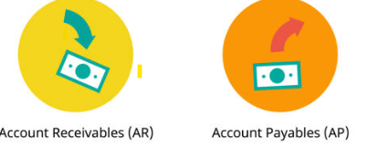
Problem Statement
Manual aging reports in SAP FICO are:
Time-consuming
Error-prone
Large datasets increase complexity
Delayed reporting affects financial decisions

Slide 3
Objective
Automate aging analysis using Python
Improve speed and accuracy
Provide structured and reliable reports
Ensure system resilience during disruptions

Slide 4
AGING ANALYSIS
Categorization of outstanding invoices by time
Helps track:
Payment delays
Cash flow health Buckets Example:
00—30 days
31—60 days
61—90 days
90+ days

Slide 5
Tools & Technologies
SAP FICO (Data Source)
Python (automation engine)
Libraries:
Pandas
NumPy
xlwings

Slide 6
Why Python?
Automation reduces manual effort
Faster processing of large datasets
High accuracy and consistency
Flexible and scalable

Slide 7
System Workflow
SAP -> Excel Export -> Python Script ->Aging Calculation -> Pivot Report ->Dashboard

Slide 8
Data Input
Sample SAP export structure Fields:
Customer/Vendor Invoice Date
Due Date
Amount

Slide 9
Process Steps
Import SAP data
Calculate aging days
Assign aging buckets
Generate pivot table
Export final report

Slide 10
Aging Bucket Classification
0–30 days → Current
31–60 days → Overdue
61–90 days → Risk
90+ days → High Risk

Slide 11
Python Implementation
Used Pandas library
Steps:
Load data into DataFrame
Convert date columns
Calculate days Overdue
Calculate aging days
Create Separate Pivot table for Receivables & Payables aging
Save to Excel

Slide 12
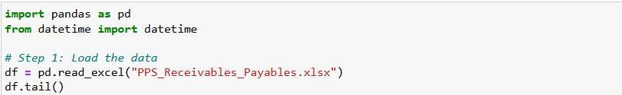
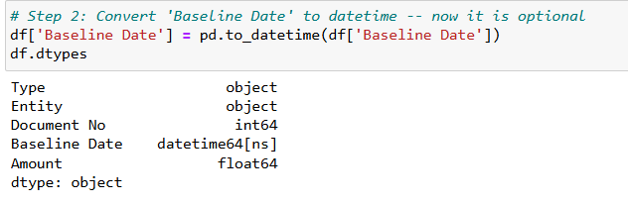
Code SNIPPET
Load Input Data
Convert date columns

Slide 13
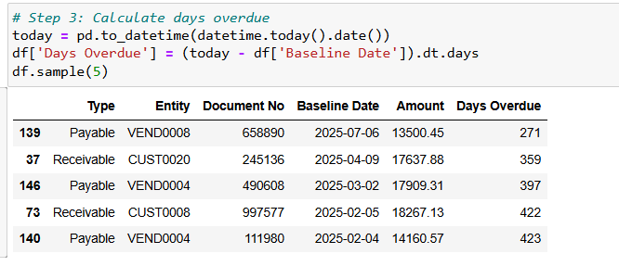
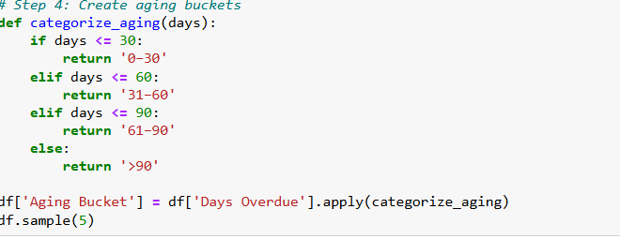
Code Highlights

Slide 14


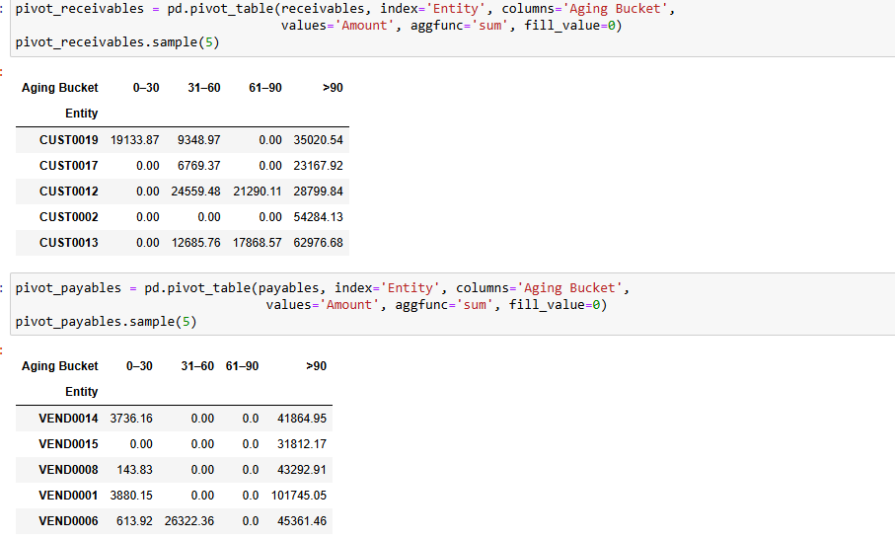
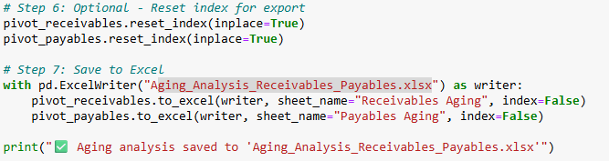
Code Highlights

Slide 15
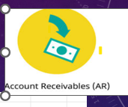
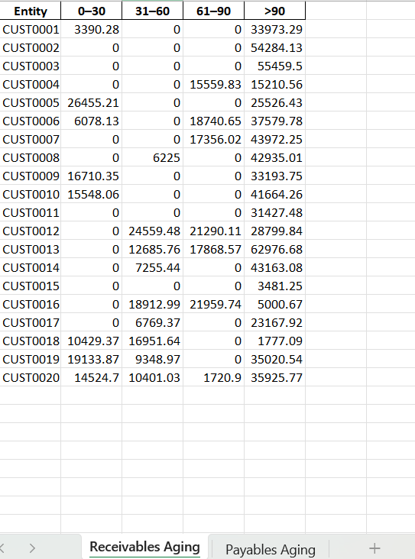
OutPUT SAVED IN EXCEL For RECEIVABLES
Aging_Analysis_Receivables

Slide 16
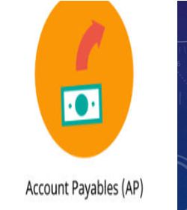
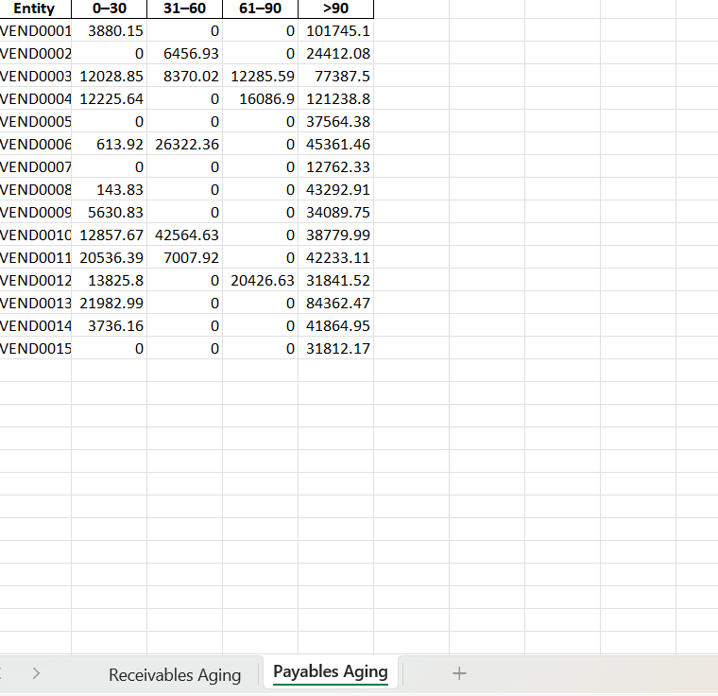
OutPUT SAVED IN EXCEL For RECEIVABLES
Aging_Analysis_Payables

Slide 17
BUSINESS Benefits
Identifies high-risk accounts
Improves accuracy
Faster reporting
Reduced human errors
Saves time and manual effort
Better financial visibility
Improved decision-making

Slide 18
Cloud & System Disturbances
Many SAP systems now run on cloud platforms like SAP S/4HANA Cloud
Risks Include:
Server downtime
Network failures
Cloud outages
Impact:
Delay in data extraction
Interrupted automation
Incomplete reports

Slide 19
Risk Impact on Aging Analysis
Delayed financial reporting
Inaccurate aging status
Missed payment follow-ups
Poor cash flow decisions

Slide 20
Mitigation Strategies
Schedule automated data exports and local backups
Use local Python processing (not fully cloud dependent)
Add validation checks for missing data
Retry mechanisms in scripts
Maintain offline data backups

Slide 21
Challenges
Data inconsistency from SAP exports
Date format issues
Handling missing/incorrect data
Dependency on system/cloud availability

Slide 22
Future Enhancements
Real-time SAP integration APIs
Automated alerts for overdue invoices
Al-based payment prediction
Dashboard integration with Tableau

Slide 23
CONCLUSION
Aging analysis is critical for finance teams
Python enhances efficiency and scalability
Python significantly improves SAP aging analysis
Automation enhances accuracy and efficiency
Integration with SAP data provides real-time insights
However, system reliability and cloud risks must be managed

Slide 24
Thank You

